Slide 1
Cluster Mining Optimization using Dynamic Bin Nonces
By: Hrishikesh, Pratyush and Akshay

Slide 2
What is Mining?
Bitcoin mining is the process by which transactions are verified and added to the public ledger, known as the blockchain, and also the means through which new bitcoin are released.
Anyone with access to the internet and suitable hardware can participate in mining. The mining process involves compiling recent transactions into blocks and trying to solve a computationally difficult puzzle.
The participant who first solves the puzzle gets to place the next block on the block chain and claim the rewards.
Notes:
Explain difficulty of hashes.

Slide 3
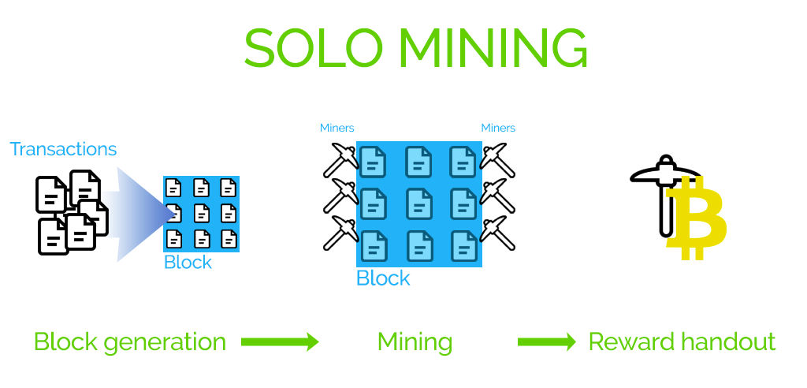

Slide 4
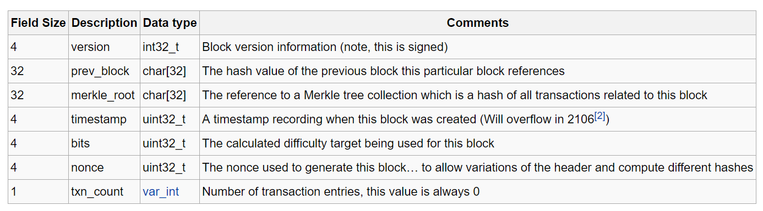
Block Header Template

Slide 5
What are Cluster Miners?
Cluster Mining is the technique used by separate nodes, which come together to pool in their resources.
The cryptographic puzzle becomes easier to solve if the processing power increases. So the more nodes that come together the better the chances are of solving the puzzle.
In cluster mining bins are allocated containing a nonce range which the system should mine across.

Slide 6
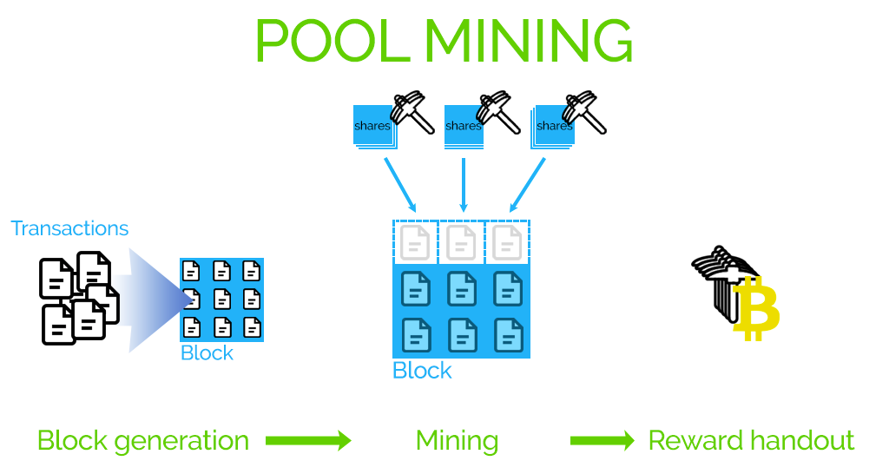

Slide 7
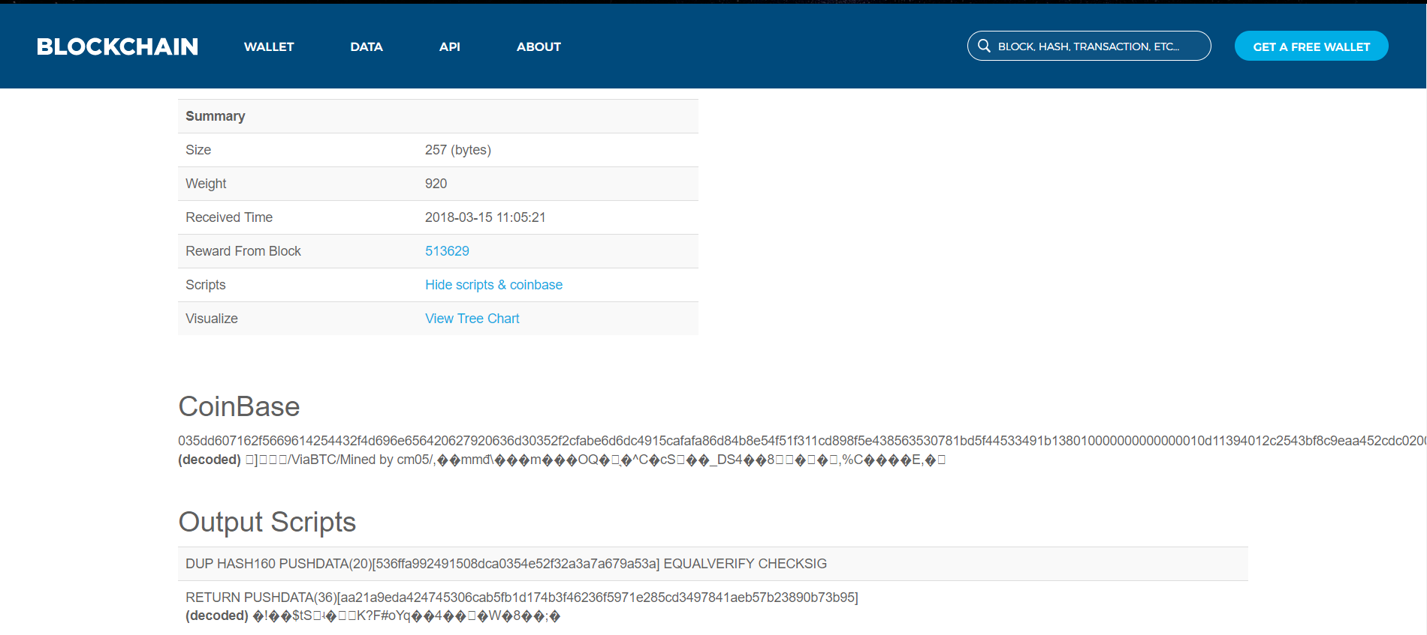

Slide 8
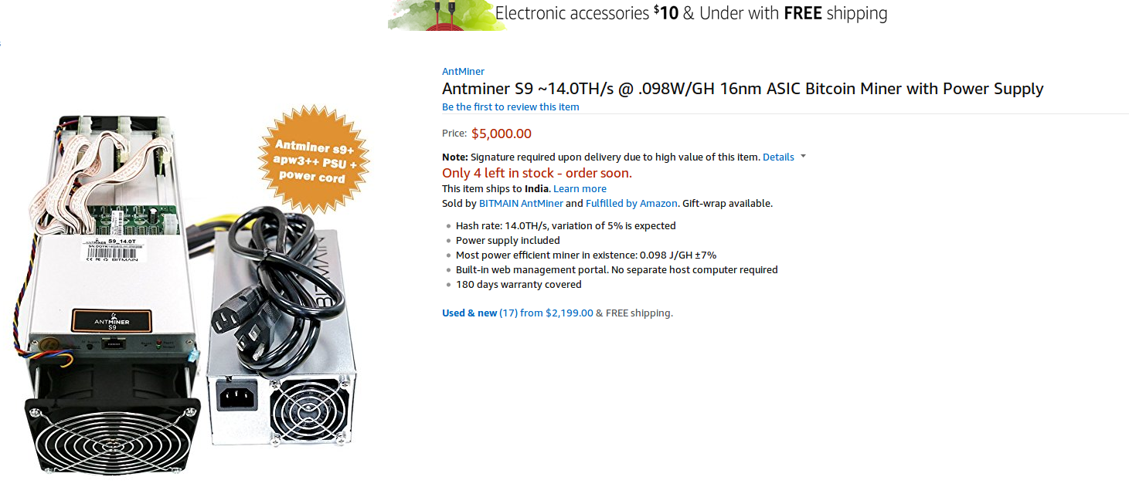

Slide 9
Our Proposal
In Cluster mining the bin sizes are allocated statically for each system which causes an issue as not every system possesses the same processing power.
To overcome this drawback we came up with an idea to dynamically allot the bin size to the mining system to minimize the latency period of the hardware devices.
This is done by reducing the network latency periods and preemption so requests between server and clients are minimized.

Slide 10
System Architecture
Server Client Architecture is present. Where the requests have been sent to the server from the client.
We have made our own endpoints:
GET /getblock
POST /newclient – params - public_key
POST /getbin – params - public_key, id

Slide 11
Comparison of Static and Dynamic
In static allocation the bin size has been fixed, whereas the dynamic follows a regression algorithm.
The algorithm takes the previous size of bin, takes the time difference between the requests.
This factor is multiplied with a hyperparameter default_time which we obtained from calculations.

Slide 12
Observations
From our analysis we observe that the static allocation uses more requests for the same bin than the dynamic algorithm proposed.

Slide 13
Result
The algorithm proposed by us, has significantly reduced the HTTP requests made by the clients which in turn reduces network latency

Slide 14
Further Improvements
Reward Calculation
Use of the extra nonce in dynamic allocation
Connect to the Blockchain network

